Slide 1

NAKUJA PROJECT N-2 BENCHMARKING OF ROCKET MODELS.
Benchmarking of rocket models of approx. 1km apogee.

Slide 2

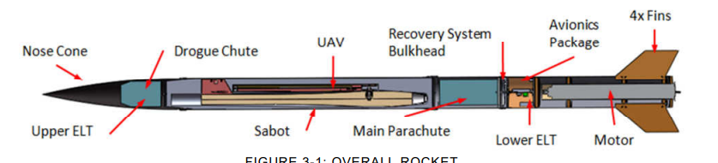
R3: mit
Altitude: 1609 m
SAIRFRAME:
Length: 322 cm
Inner diameter: 16.51 cm
Mass: 20.18 kg (excluding payload mass of 3.18kg)
Material: Fiberglass and carbon fiber
Nose cone: tangent ogive with length of 68.58 cm
MOTOR CHOICE:
Cesaroni L1115: 75mm in diameter, 62 cm in length, and has a total impulse of 4908 Newton seconds over a 4.49 second burn time.
RECOVERY SYSTEM:
Main parachute diameter: 274 cm
Drogue chute diameter: 91 cm
Rocket will be recovered in two pieces: nose cone, sabot, and drogue parachute in one piece and the body tube and main parachute in another piece

Slide 3
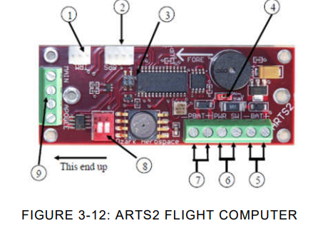
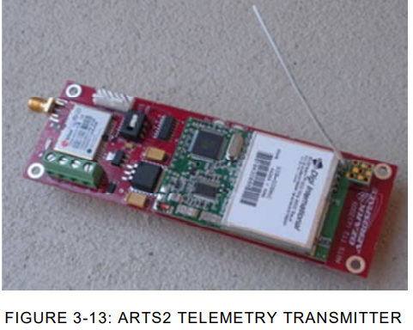
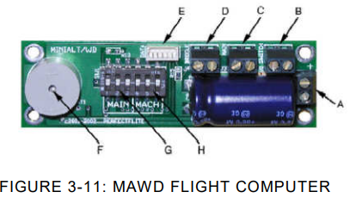
AVIONICS:
miniAlt/WD flight computer: backup altimeter that measures the rockets altitude during launch and stores in on the computer board
ARTS2 flight computer: handles primary parachute deployment as well as determining the rocket state variables and flight states.
ARTS2 Transmitter: transmits the data from the ARTS2 to the ground station receiver.
Power Supply :
Three 9 volt batteries will provide power for the flight computers and transmitters.

Slide 4
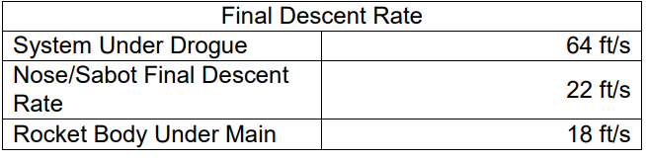
RECOVERY SUBSYSTEMS:
Drogue chute deploys at apogee supporting a total weight 23 kg – it will achieve a descent rate of 19.51 m/s
At an altitude of 762 m, tether securing the sabot inside the rocket will release, allowing the drogue parachute to pull the sabot and the main parachute out of the rocket. the rocket body will separate from the sabot/nose/drogue section and free fall as the main parachute deploys.
the remaining structure has a mass of 15 kg. With a 9ft diameter parachute, a final descent rate of 5.49 m/s can be achieved.
Under the 91 cm parachute, the nose cone and sabot will have a final descent rate of 6.71 m/s.

Slide 5
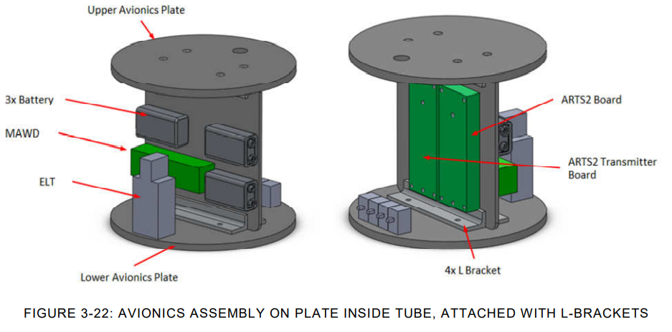

Slide 6

Thank You!
References:
https://www.academia.edu/29742847/MIT_Rocket_Team_Preliminary_Design_Review?pop_sutd=false
Ogweno Emmanuel

